Slide 1
Qualcomm Makeathon
Timeline Application Challenge - Final Design
Submitted by - Team ‘TOO’
Soumyarup Lahiri
Shubham Saha
Pranav A. Taukari

Slide 2
Objective
To create an event timeline for the debug log output given by the ATH10K Driver and display it in an understandable manner

Slide 3
The problem explained
ATH10K is the mac80211 wireless driver for Qualcomm Atheros QCA988x family of chips, which support IEEE 802.11ac.
The driver provides a lot of information in the form of debug log outputs, which can be accessed by setting the debug mask in the ath10k_core module.
When the router has been running for a long time, there are a large number of log outputs that get generated, which contain information on the interaction between the AP (Access Point) and the STA (Station/Client).
These log outputs can be easily accessed, but are difficult to read as the errors and warnings are in hexadecimal form.
The challenge is to parse these messages in a human readable form, for rapid debugging of any issues that may occur.

Slide 4
What we did
We were given the Archer C6 wireless router, which is powered by the Qualcomm Atheros 9888 Chipset.
The firmware of the router was removed, and OpenWrt was installed in its place.
A custom image of the OpenWrt firmware was compiled using the menuconfig utility with kmod-ath10k & debug enabled.
We also included support for kernel tracing and the busybox utility crond for scheduled execution of scripts.
The device was boot up, and all the debug messages were obtained in order to be examined.

Slide 5
What we did [Contd.]
A script was written in the router itself which takes the log output produced by the ath10k driver and puts it in a file, which can then be accessed later.
We installed the trace-cmd package, which is a front-end user space tool for ftrace (a utility for tracing kernel functions), but then shifted to using debug instead of trace to get the error messages.
The cron utility was used on the router side to schedule the execution of the script to update the contents of the log output file periodically (automatically from router startup). This ensures that the debug information is up-to-date (in real-time).

Slide 6
What we did [Contd.]
A simple menu based interface was developed on the laptop connected to the router in order to fetch the debug messages and parse them. The menu interface is designed to tolerate basic incorrect inputs.
The file containing the log output that was created in the router can be fetched using scp. The messages are parsed from the log output, and subsequently printed in the terminal in a human readable format.
All the STAs that are connected have their log history stored in files identified by their MAC addresses. Through the menu interface, the parsed messages for a particular STA can be displayed.
A file contains a list of all the MAC addresses that connected with the router.

Slide 7
What we did [Contd.]
Once the basic menu interface was set-up, we started working on a GUI application to run everything as a stand alone app.
The GUI was created and all the functionality was integrated.

Slide 8
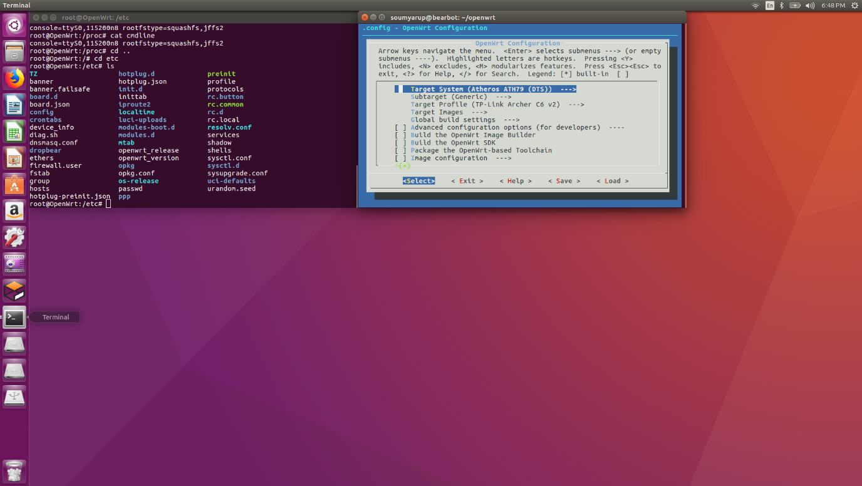
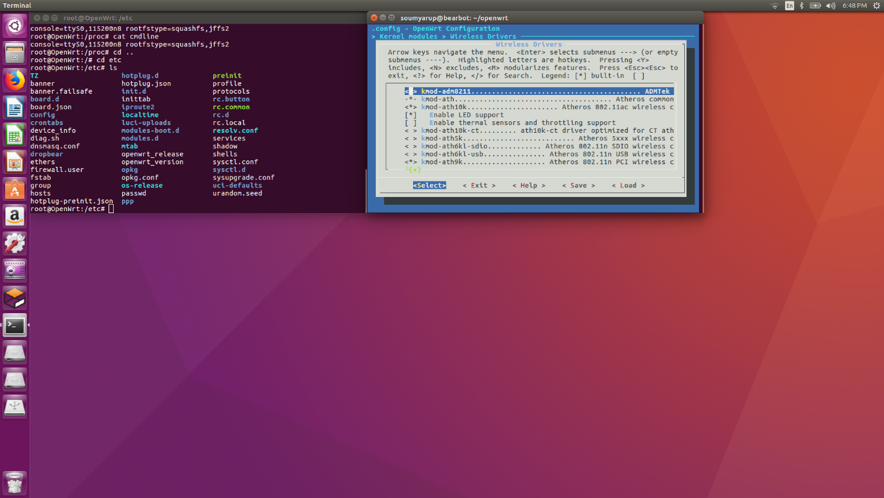
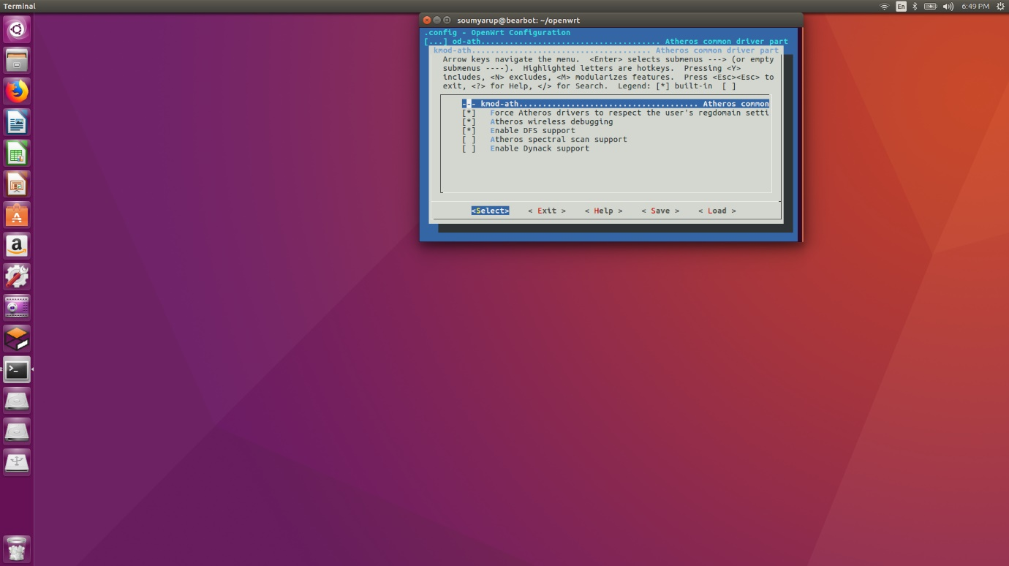
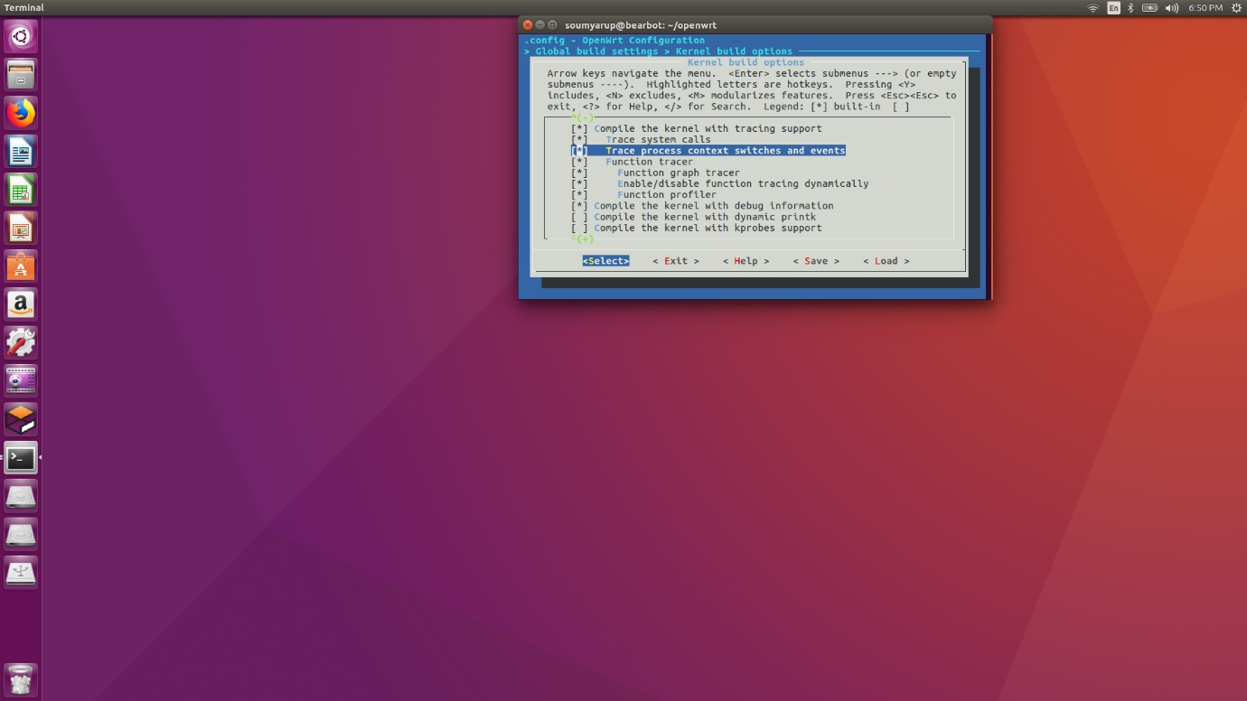
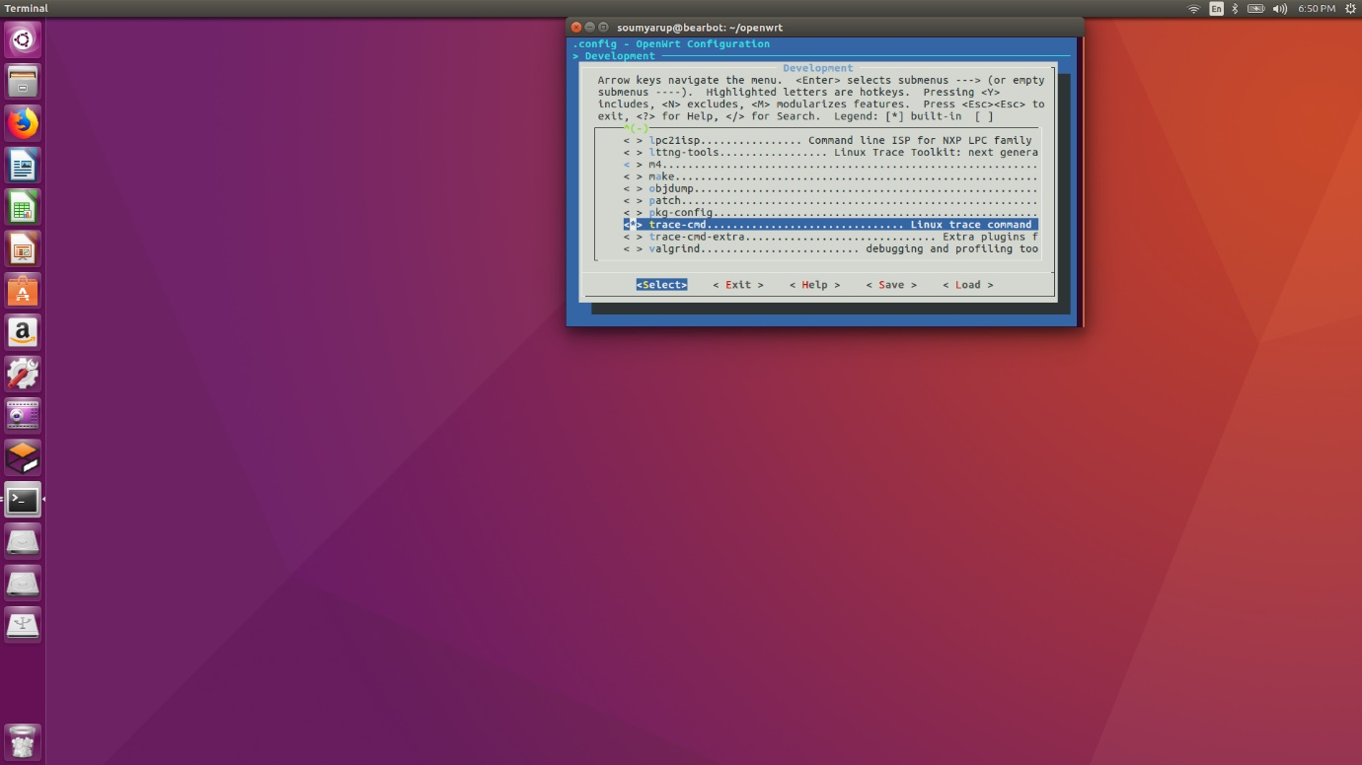
Compilation

Slide 9
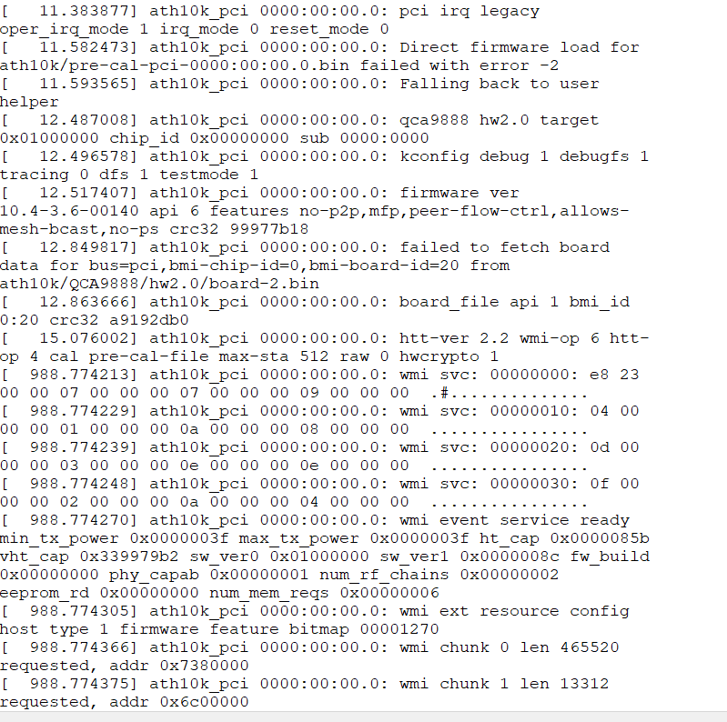
File containing the log output

Slide 10
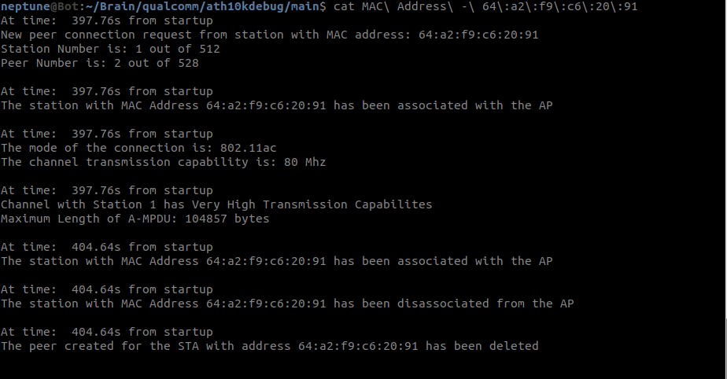
Parsed log output

Slide 11
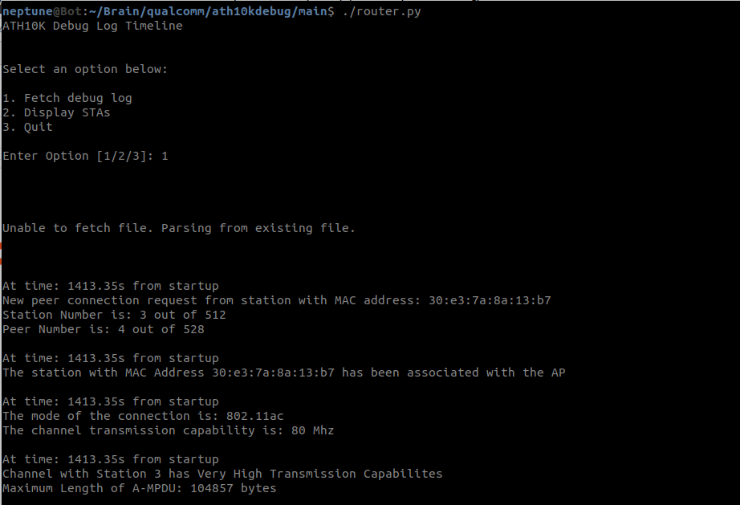
Parsed log output (Menu Interface)

Slide 12
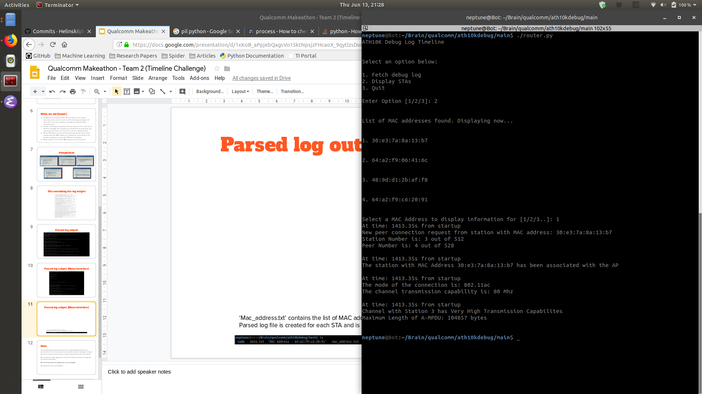
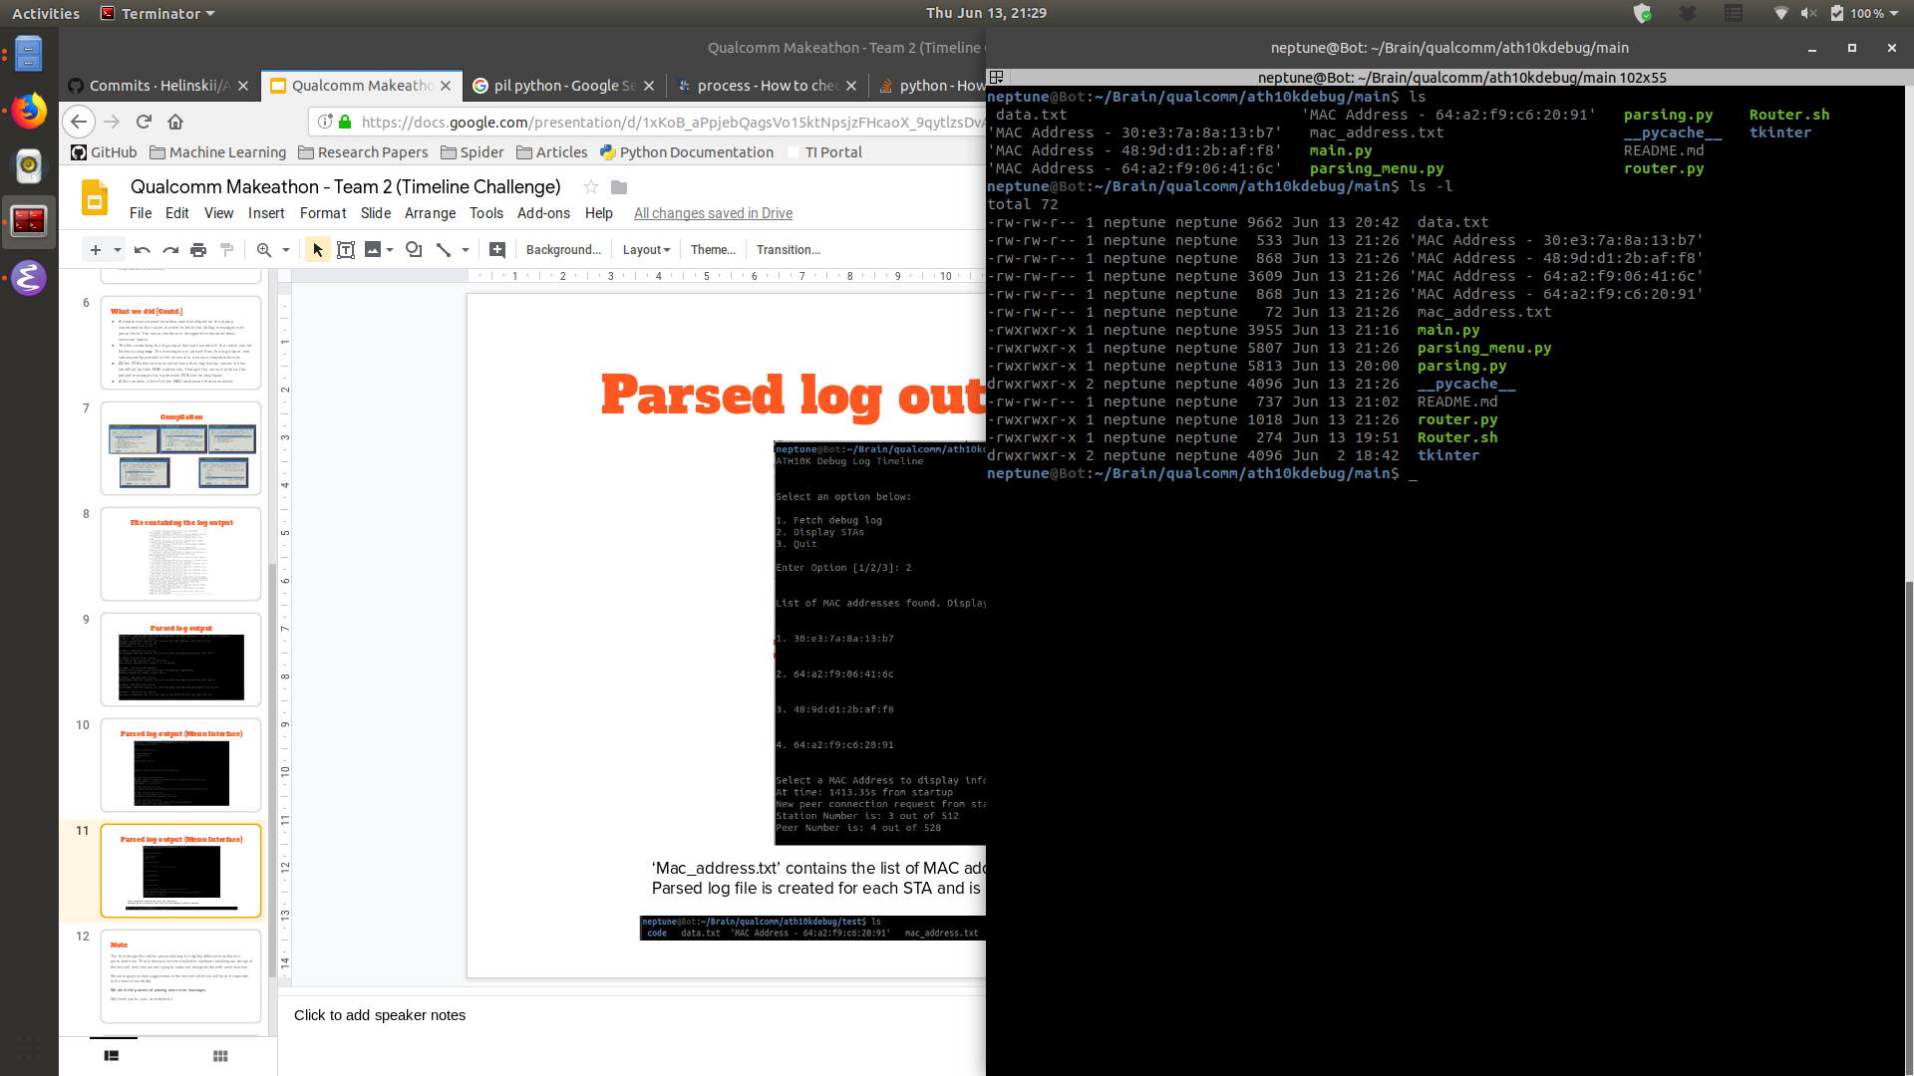
Parsed log output (Menu Interface)
‘mac_address.txt’ contains the list of MAC addresses.
Parsed log file is created for each STA and is identified by the MAC address.

Slide 13
Algorithm Explained
Parsing Statements:
The Algorithm analyses the raw log file line-by-line.
In a simple yet efficient manner, it looks for keywords present in each line.
Based on the keywords, text has been added to convey the information in a more human readable format.
For every raw debug line, the parsed output is stored in a file along with the time (from Router startup) at which the ATH10K driver output the statement.
Everything is categorized based on the STA MAC Address that is given in the raw output line itself.

Slide 14
Algorithm Explained
Parsing hex-codes:
There are certain hex-codes printed in the raw log that convey information on WMI Peer Flags.
These hex-codes are parsed in to the corresponding flags using another algorithm that analyzes the hex-code bit by bit.
The WMI flags also depend on the WMI version that is being used. We have only taken the WMI Main version for simplicity.
We identified a pattern that maps the hex-codes to the WMI Peer Flags, and the algorithm utilizes that pattern.

Slide 15
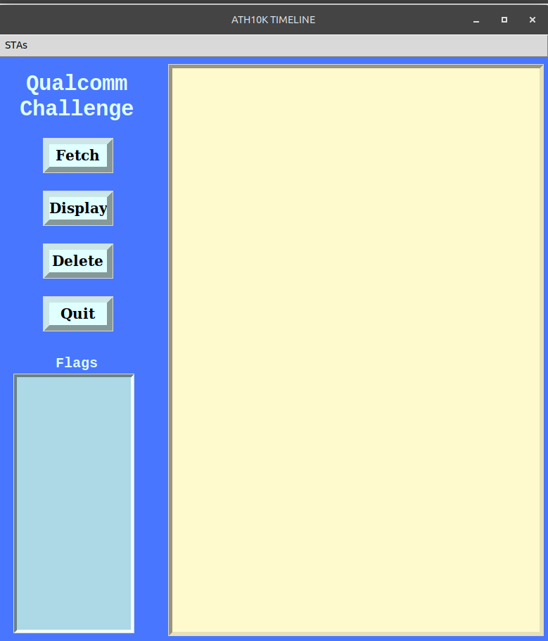
GUI Application

Slide 16
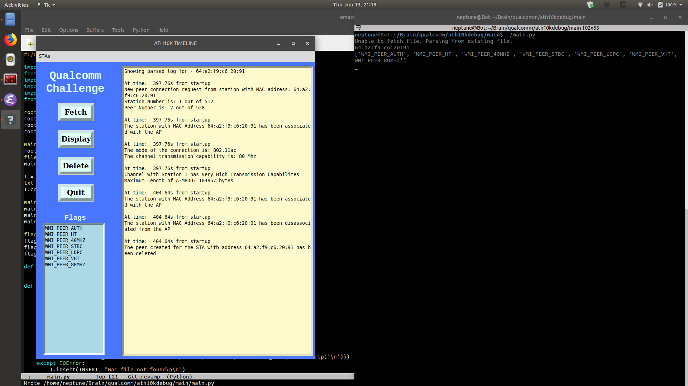
GUI Application

Slide 17
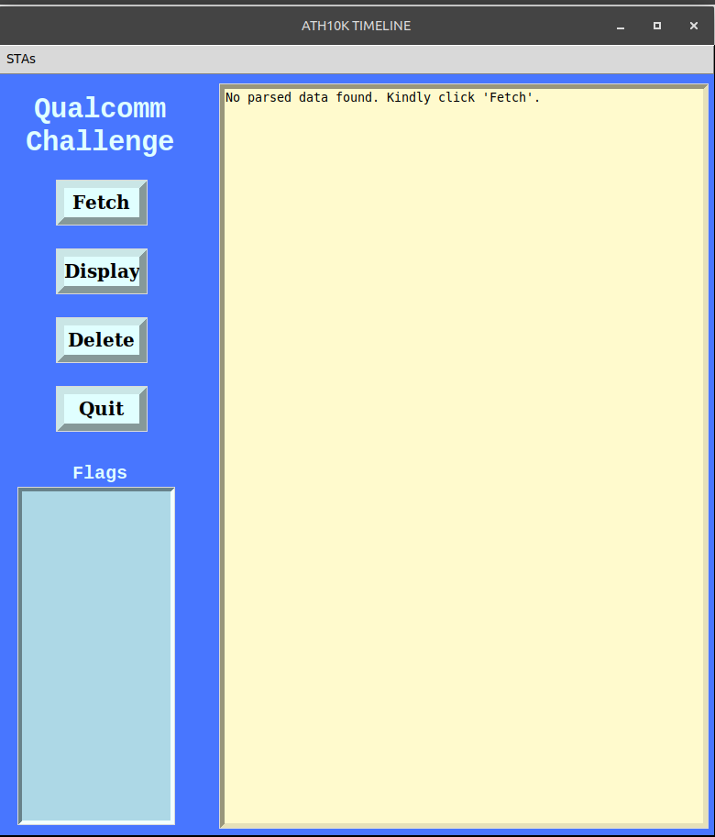
GUI Application

Slide 18
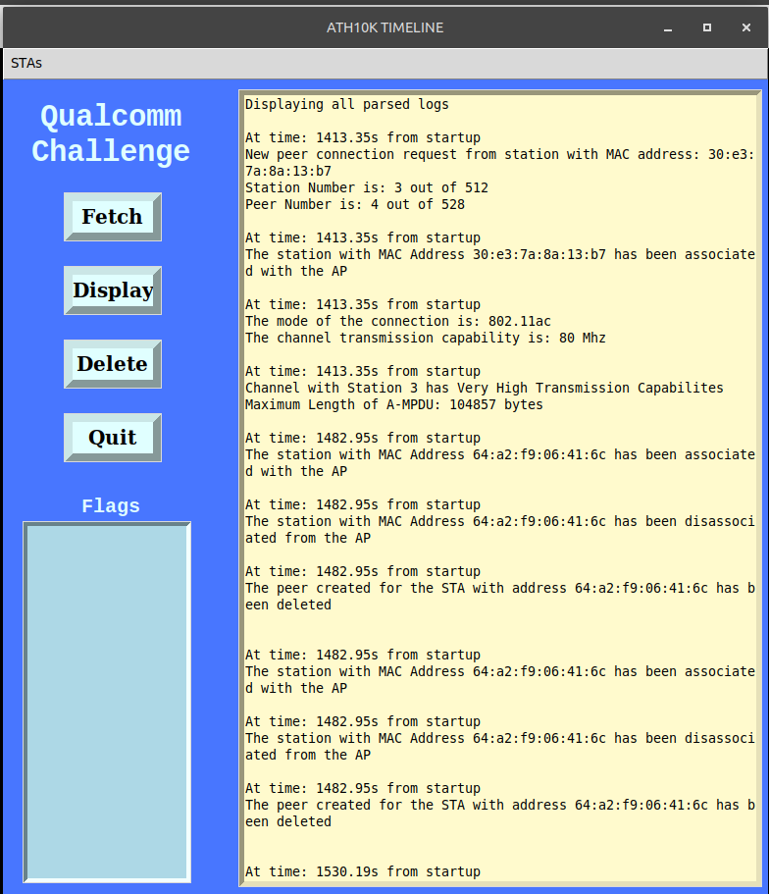
GUI Application

Slide 19
Pros & Cons
Pros:
Simple yet efficient algorithm to debug messages.
Hex-codes are properly decoded and WMI Peer Flags are printed.
Minimalistic GUI that is intuitive to understand, even for a new user.
Can be used in a development environment in order to efficiently parse raw data when a lot of STAs are present.
Cons:
More debug messages can be parsed for more information on the Router activity.

Slide 20
Scaling this application
In order to scale this application in the future, the following can be done:
All the debug messages are given in the ‘mac.c’ file of the ATH10K driver source-code, and hence they can be understood.
Based on the raw messages above, keywords can be identified in the raw log, and can be further parsed.
WMI versions can be identified in order to map WMI Peer Flags for those versions (other than the Main version).

Slide 21
A brief summary
The following was implemented:
Customized firmware of OpenWRT was flashed into the router.
Raw log data was periodically and automatically fetched from the router.
An application was created that parses the raw log data, categorizes it based on the STA, decodes hex-codes, and displays it in a human readable format.

Slide 22
Fin.

